Slide 1
JIU IT Major 20230124 PMJ, AEJ
Object-Oriented Programming
Practice Week5

Slide 2
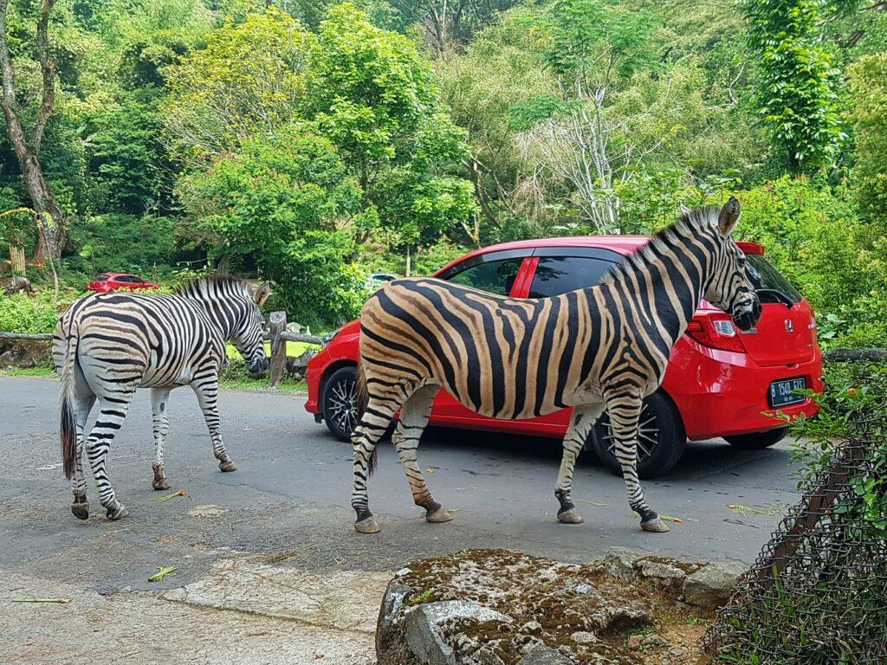
How was
Your Weekend?

Slide 3

Today we have
NASI + Go
😚 😚 😚

Slide 4
Selection Sort

Slide 5
Selection Sort
repeatedly selecting the smallest (or largest)
element from the unsorted portion of the list
and moving it to the sorted portion of the list

Slide 6
Selection
Sort

Slide 7
Selection Sort

Slide 8
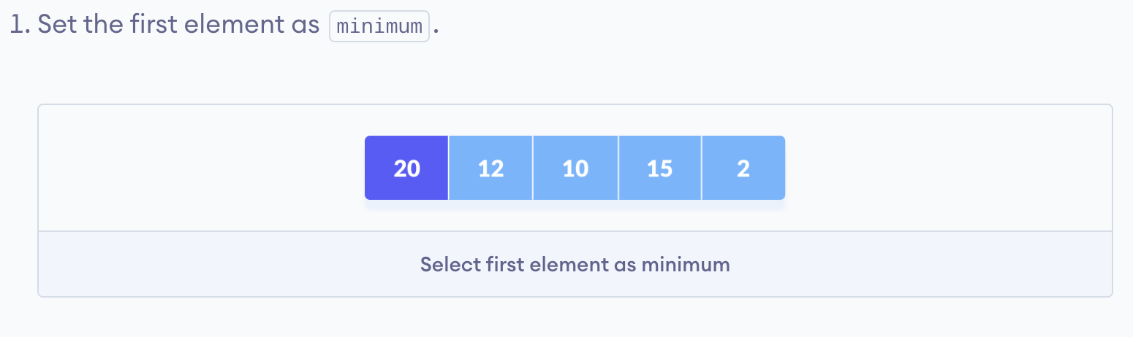
Selection Sort

Slide 9
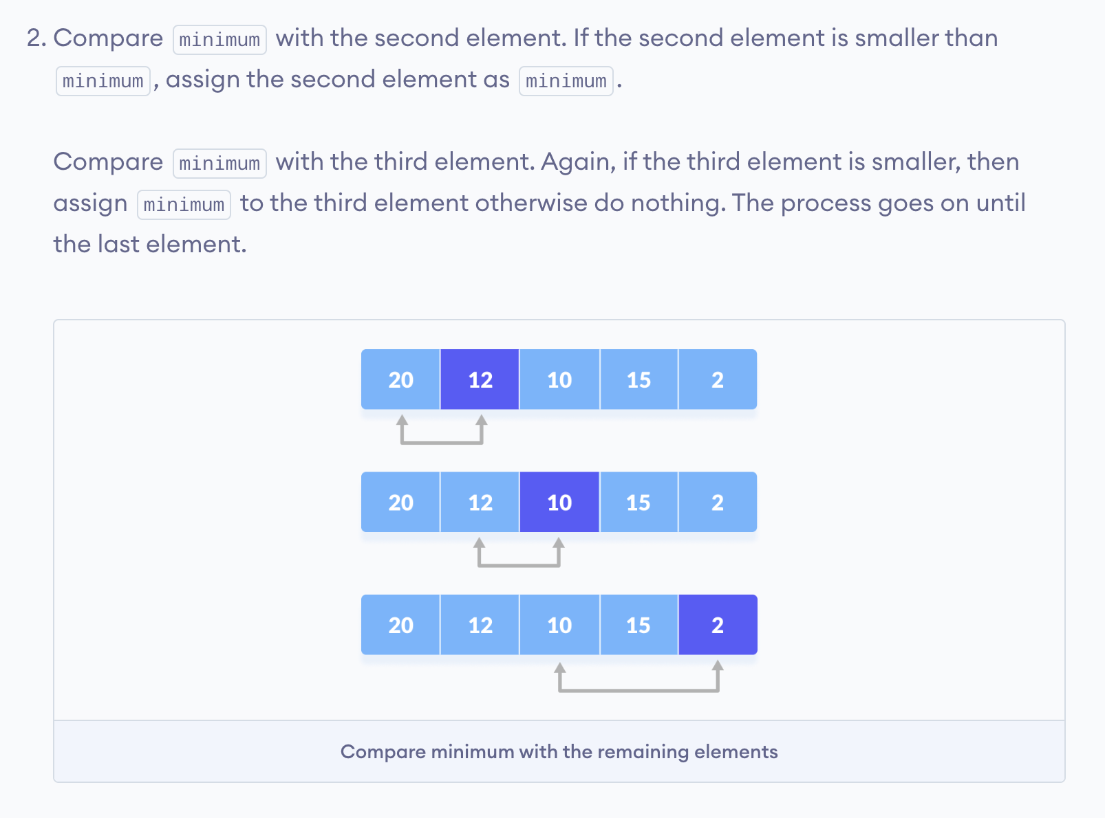
Selection Sort

Slide 10
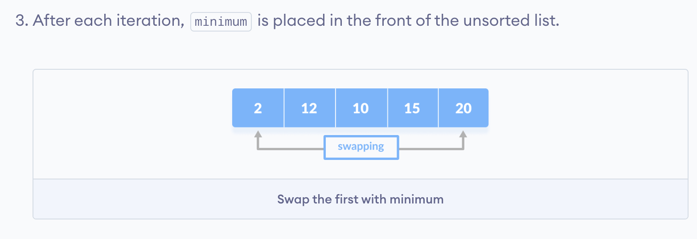
Selection Sort

Slide 11
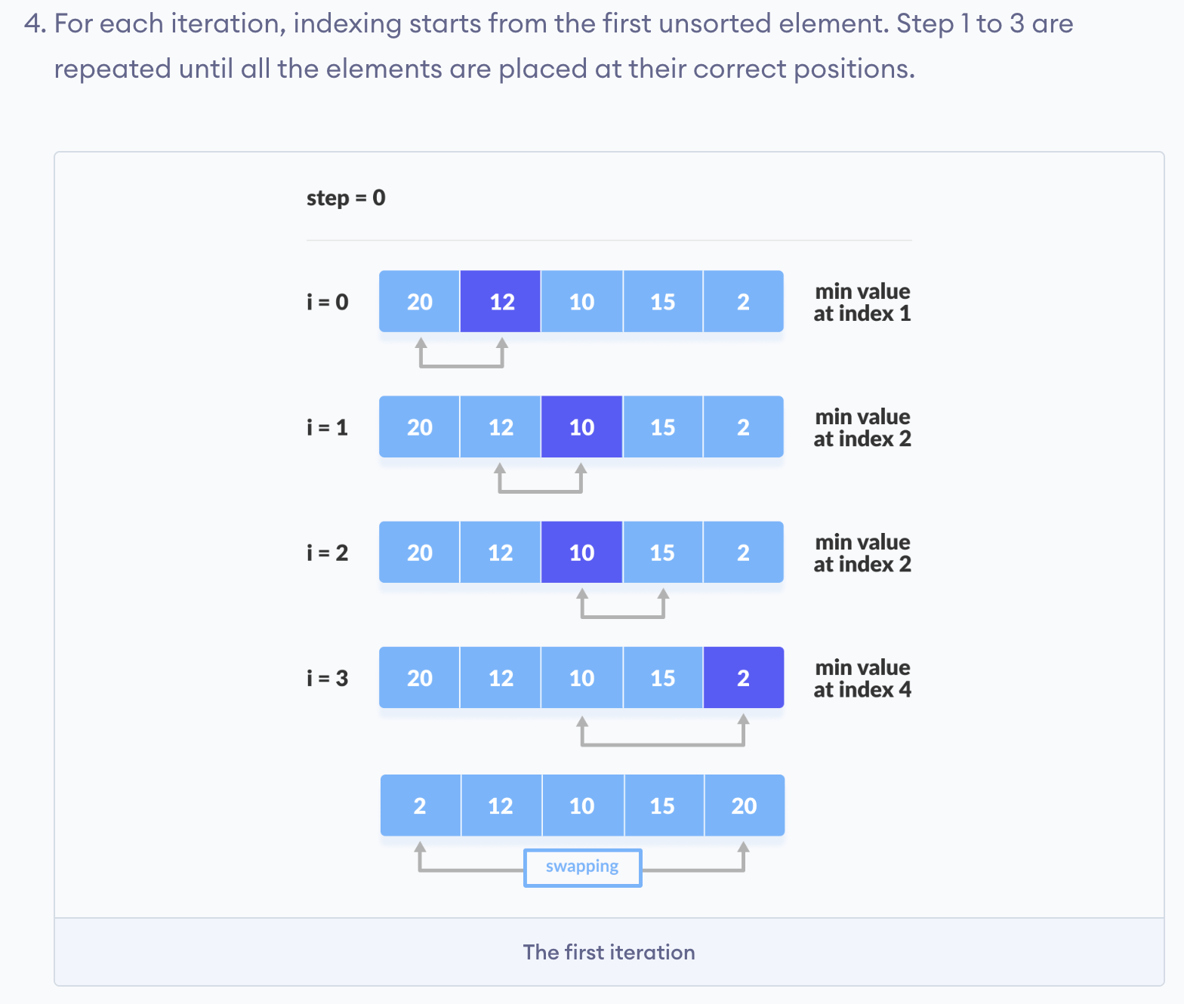
Selection Sort

Slide 12
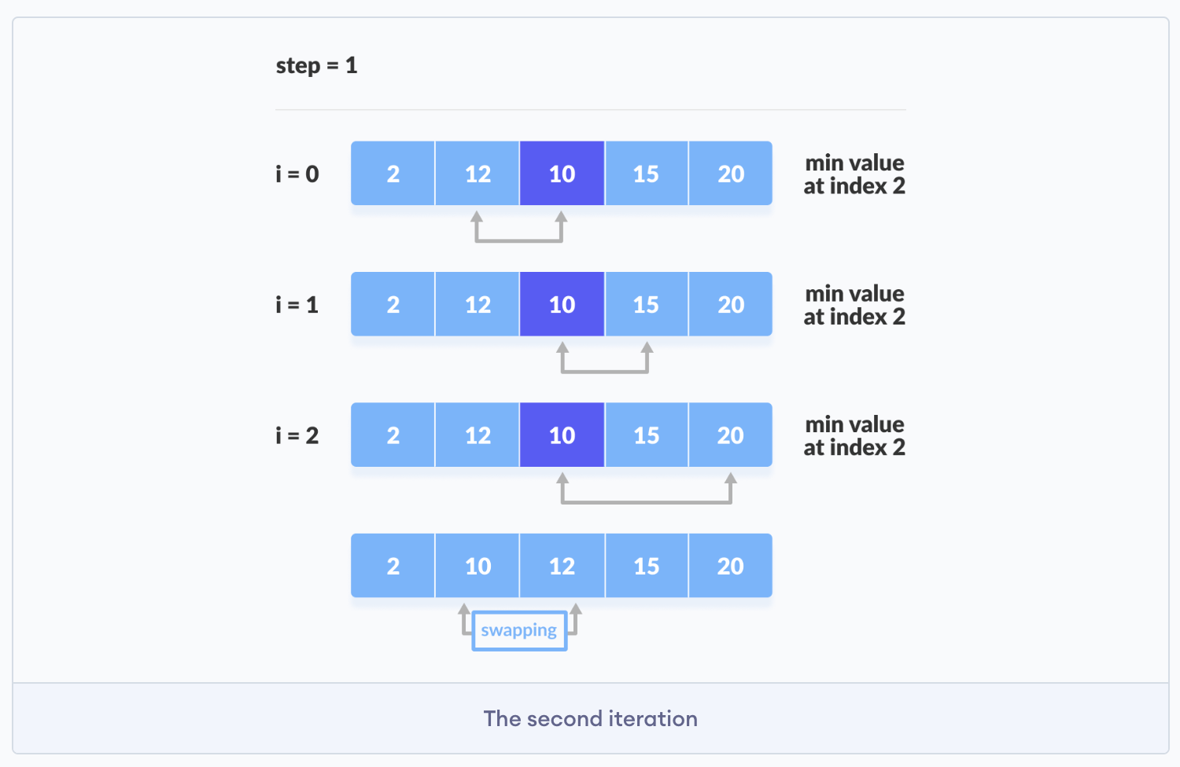
Selection Sort

Slide 13
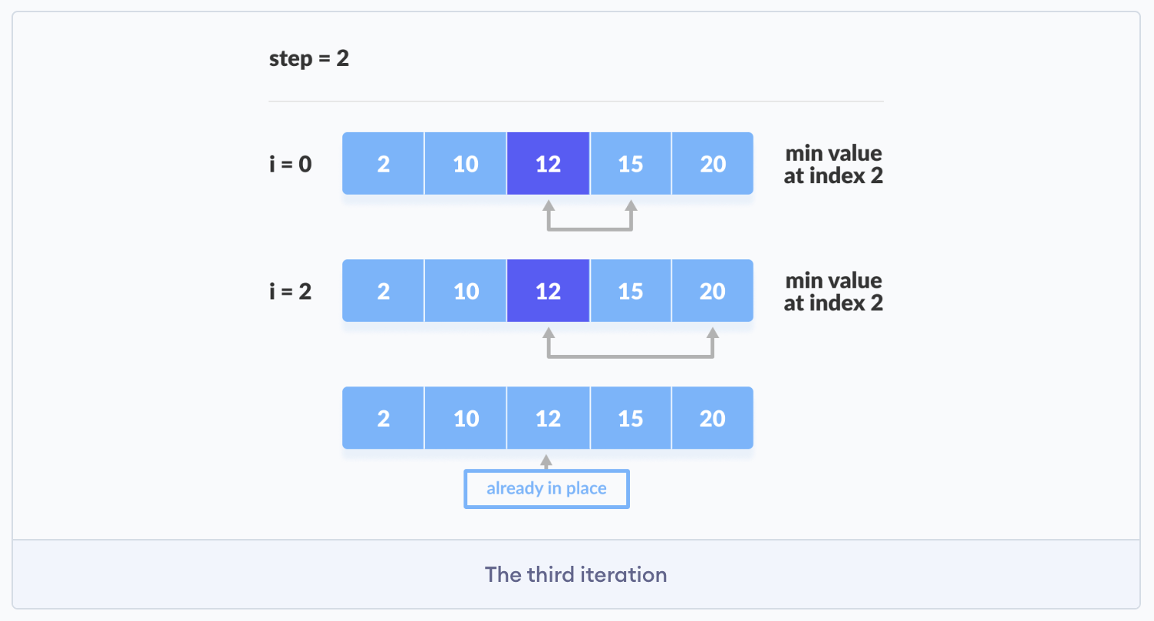
Selection Sort

Slide 14
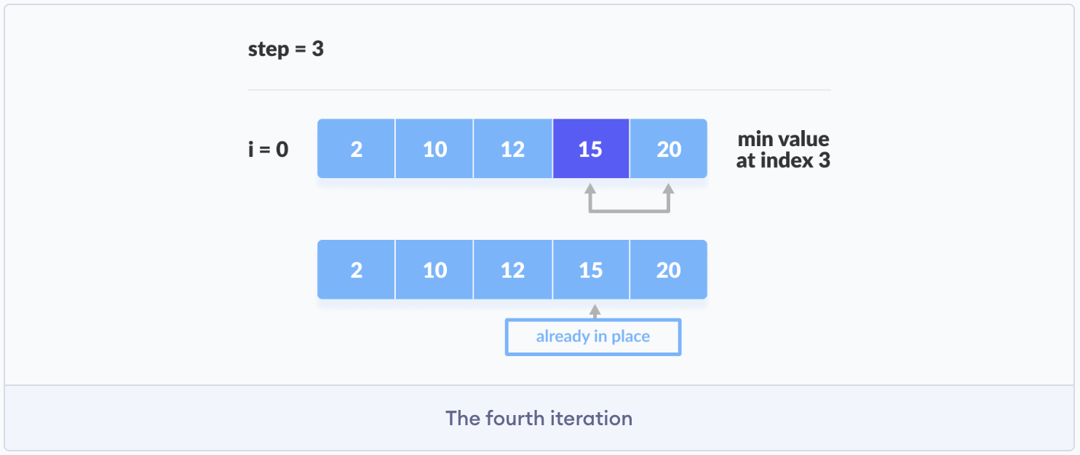
Selection Sort

Slide 15
Binary Search

Slide 16
Binary Search
Binary Search is a searching algorithm for finding an element's position in a sorted array.

Slide 17
Binary Search
Binary Search is a searching algorithm for finding an element's position in a sorted array.

Slide 18
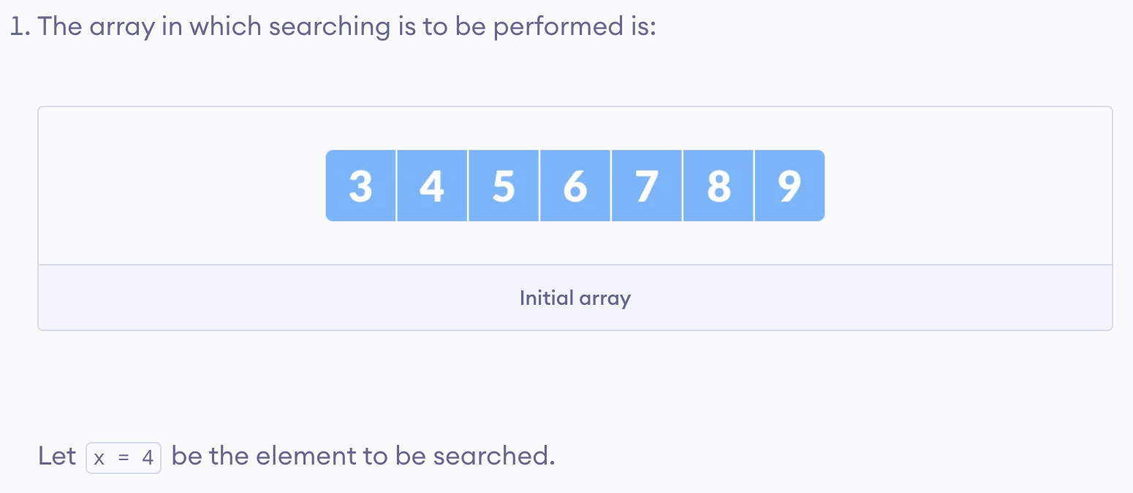
Binary Search
Binary Search is a searching algorithm for finding an element's position in a sorted array.

Slide 19
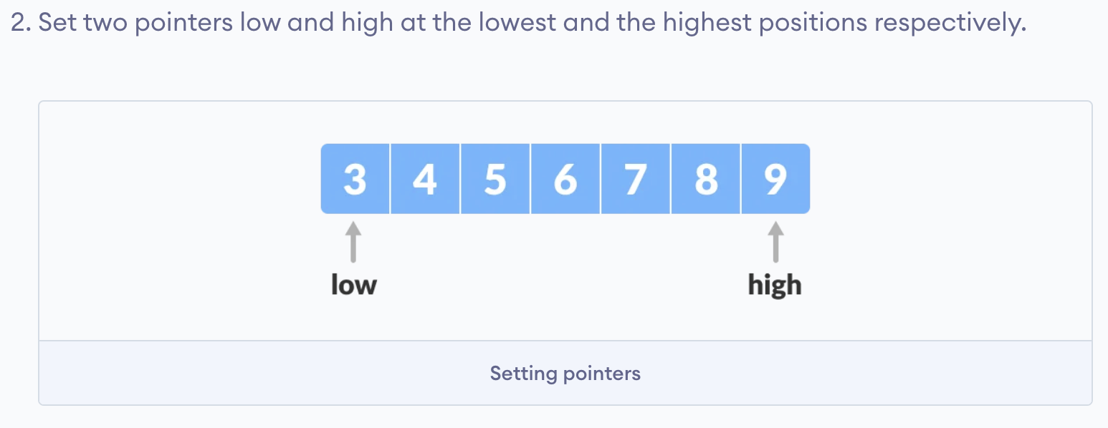
Binary Search
Binary Search is a searching algorithm for finding an element's position in a sorted array.

Slide 20
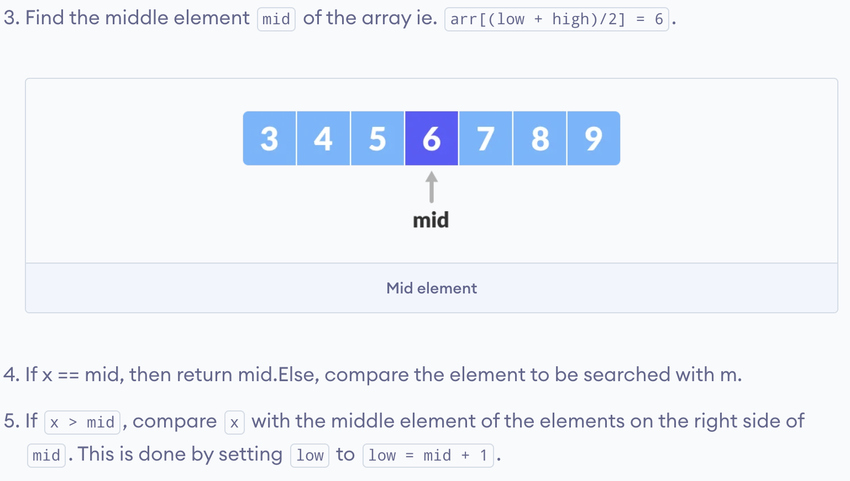
Binary Search
Binary Search is a searching algorithm for finding an element's position in a sorted array.

Slide 21
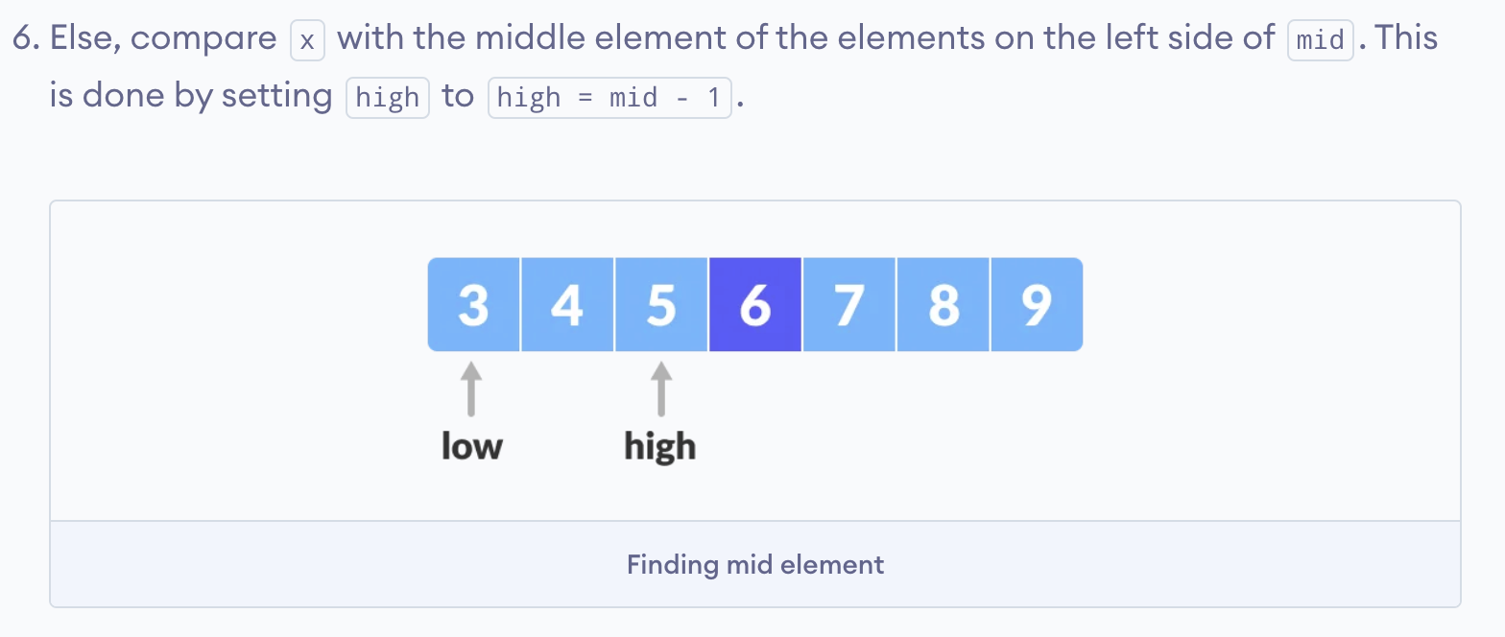
Binary Search
Binary Search is a searching algorithm for finding an element's position in a sorted array.

Slide 22
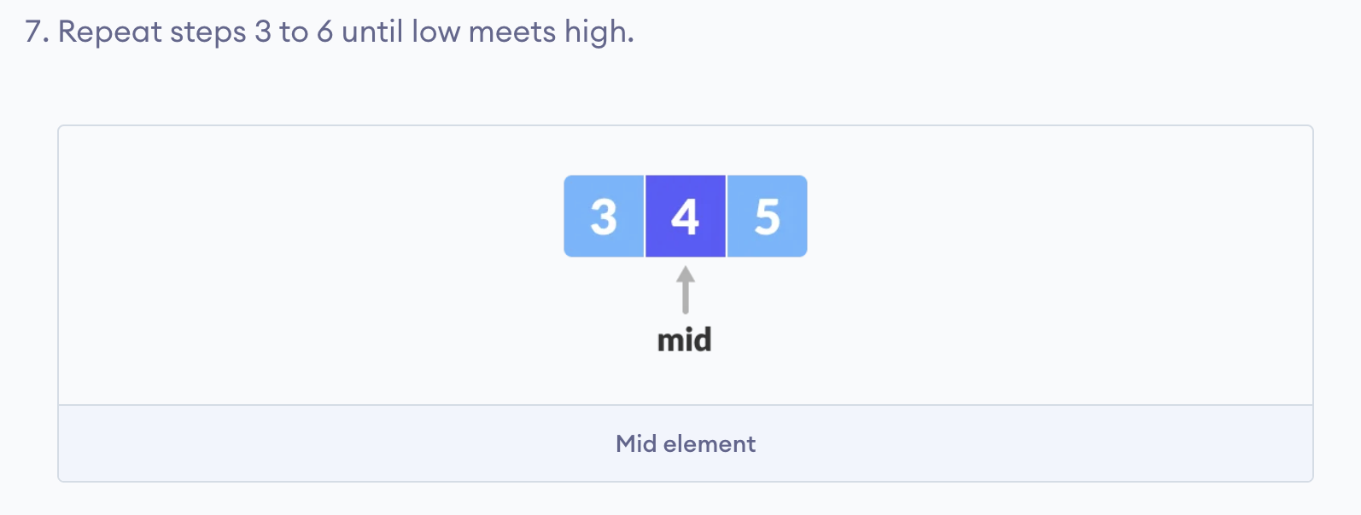
Binary Search
Binary Search is a searching algorithm for finding an element's position in a sorted array.

Slide 23
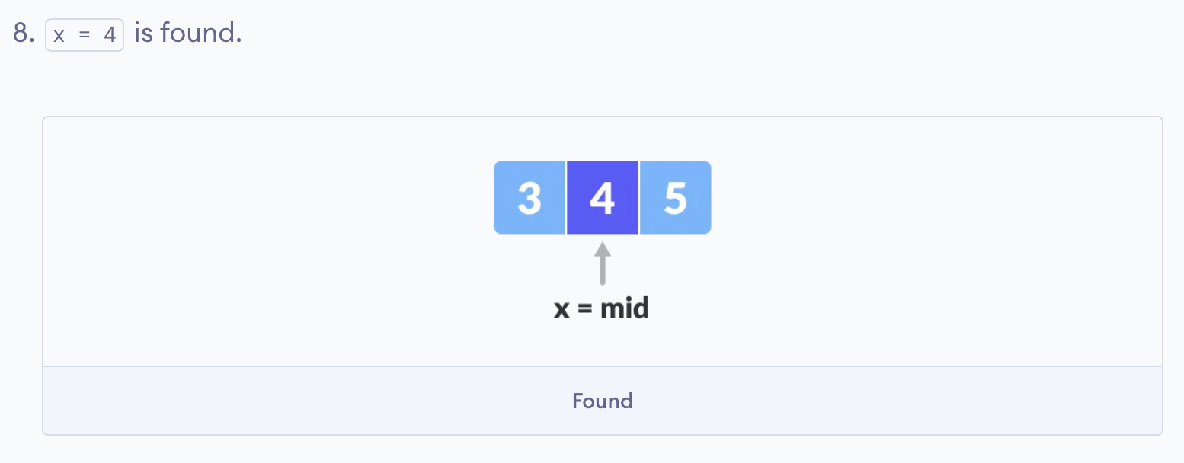
Binary Search
Binary Search is a searching algorithm for finding an element's position in a sorted array.

Slide 24
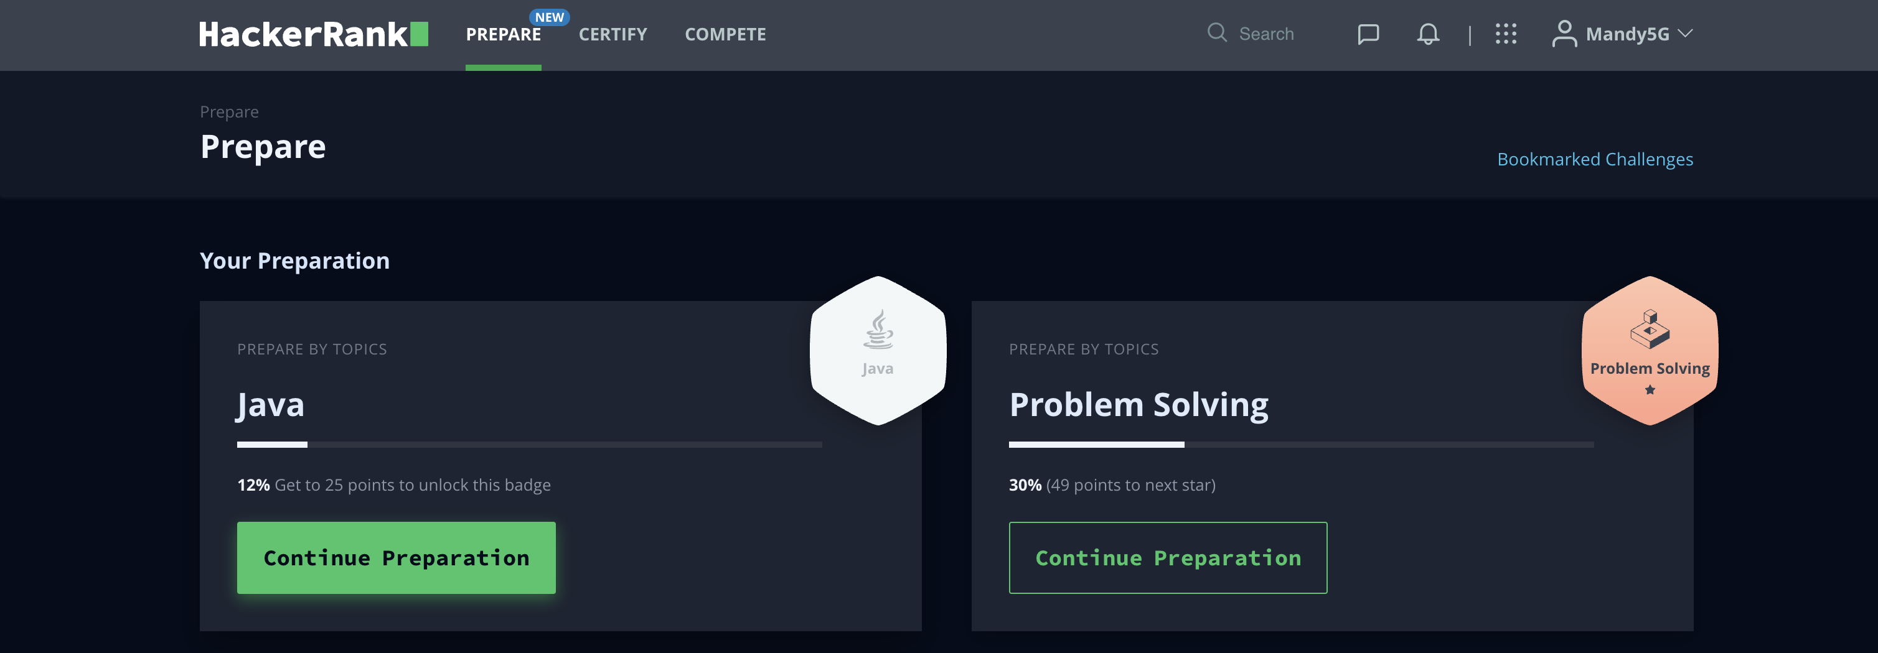
https://www.hackerrank.com/

Slide 25
Introduction to Java
The term Java from Java island….
JIU IT Major 20230124 PMJ, AEJ

